Slide 1
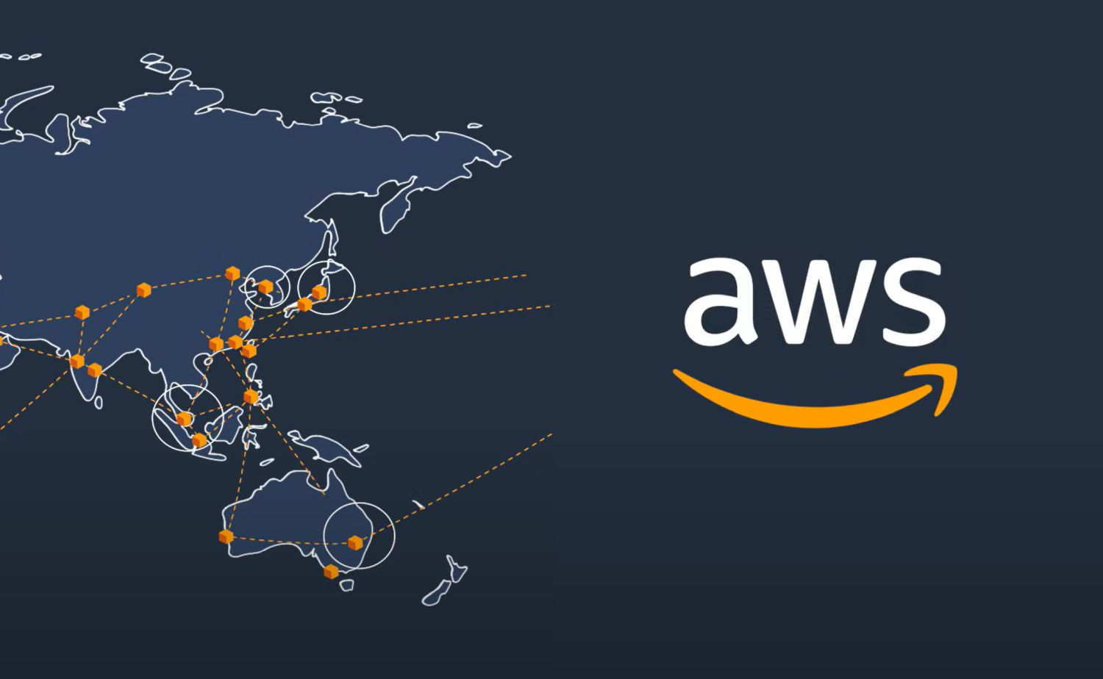
INTRODUCTION TO CLOUD COMPUTING

Slide 2
Definition of Cloud Computing
Cloud computing refers to the delivery of computing services—servers, storage, databases, networking, software, analytics, and more—over the internet (“the cloud”).
It allows for on-demand access to these resources, enabling flexible, scalable, and cost-effective computing solutions.
Historical Context
Evolved from early network computing and virtualization technologies.
Cloud computing has transformed IT infrastructure and service delivery, becoming a cornerstone of modern business operations.

Slide 3
Characteristics of Cloud Computing
On-Demand Self-Service
Broad Network Access
Resource Pooling
Rapid Elasticity
Measured Service

Slide 4
Cloud Service Models
Infrastructure as a Service (IaaS)
Overview: Provides virtualized computing resources over the internet.
Examples: Amazon EC2, Google Compute Engine, Microsoft Azure VM.
Use Case: Hosting applications, storage, and networks in a virtual environment.
Platform as a Service (PaaS)
Overview: Offers hardware and software tools over the internet, often used for application development.
Examples: AWS Elastic Beanstalk, Google App Engine, Microsoft Azure App Services.
Use Case: Developers building web applications without worrying about underlying infrastructure.
Software as a Service (SaaS)
Overview: Delivers software applications over the internet, on a subscription basis.
Examples: Google Workspace, Microsoft 365, Salesforce.
Use Case: End-users accessing software applications hosted in the cloud.

Slide 5
Cloud Deployment Models
Public Cloud
Services offered over the public internet and available to anyone who wants to purchase them.
Advantages: Cost-effective, scalable, and easy to use.
Examples: AWS, Microsoft Azure, Google Cloud.
Private Cloud
Cloud computing resources used exclusively by one business or organization.
Advantages: Enhanced security, compliance, and control over data and applications.
Examples: VMware Cloud, OpenStack.
Hybrid Cloud
A combination of public and private clouds, allowing data and applications to be shared between them.
Advantages: Greater flexibility, optimized infrastructure, and cost management.
Examples: AWS Outposts, Azure Arc, Google Anthos.

Slide 6
Benefits of Cloud Computing
Cost Efficiency
Pay-as-you-go model reduces capital expenditure and operational costs by paying only for what you use.
Scalability
Easily scale resources up or down based on demand, without the need for large upfront investments in hardware.
Flexibility
Access to a broad range of services and tools that can be customized to meet specific needs.
Disaster Recovery and Business Continuity
Built-in data redundancy and recovery options ensure minimal downtime in case of a disaster.
Collaboration and Accessibility
Cloud-based tools allow teams to collaborate in real-time from any location with internet access.

Slide 7
Challenges of Cloud Computing
Security and Privacy Concerns
Storing sensitive data in the cloud requires robust security measures and compliance with regulations.
Solution: Implement strong encryption, access controls, and regular audits.
Downtime and Reliability
Cloud services can experience outages, impacting availability.
Solution: Choose reputable providers and implement multi-region deployment for high availability.
Cost Management
Without proper management, costs can spiral due to resource overuse.
Solution: Use budgeting tools and regularly monitor cloud usage.
Vendor Lock-In
Moving from one cloud provider to another can be complex and costly.
Solution: Use multi-cloud strategies and standardized technologies where possible.

Slide 8
Emerging Trends in Cloud Computing
Edge Computing
Overview: Processing data closer to where it is generated, at the "edge" of the network.
Benefits: Reduced latency, improved performance for IoT devices.
Serverless Computing
Overview: Running applications without managing servers, where the cloud provider automatically scales resources.
Benefits: Simplifies deployment and reduces costs.
Multi-Cloud Strategies
Overview: Using multiple cloud services from different providers to avoid vendor lock-in and optimize performance.
Benefits: Flexibility and resilience.

Slide 9
Cloud Security Best Practices
Data Encryption
Encrypt data both in transit and at rest to protect against unauthorized access.
Identity and Access Management (IAM)
Implement strict access controls and multi-factor authentication (MFA) to secure cloud resources.
Regular Audits and Compliance
Regularly audit cloud configurations and ensure compliance with industry standards and regulations.
Automated Monitoring and Alerts
Use cloud-native monitoring tools to detect and respond to security incidents in real-time.

Slide 10
Future of Cloud Computing
AI and Machine Learning Integration
Continued integration of AI/ML with cloud services, enabling smarter, more adaptive applications.
Quantum Computing
Cloud providers exploring quantum computing as a service, offering new possibilities for complex problem-solving.
Sustainability and Green Computing
Increasing focus on energy efficiency and reducing the carbon footprint of cloud data centers.

